Slide 1
Tutorial 04
T01/02

Slide 2
Quick Recap

Slide 3
Inter-process Communication
Why?
Processes with independent memory regions may cooperate
Two common mechanism
Shared memory
Message passing
Two Unix-specific IPC mechanism
Pipe
Signal

Slide 4
Shared Memory
Shared Memory
M
Involve OS
Involve OS
1.Create and attach to M
1.Attach to M
2.Read/Write to M
2.Read/Write to M
Normal access
Process 1
Process 2

Slide 5
Shared Memory - Pros and Cons
Pros | Cons
Efficient Only creating and attaching shared memory involves OS Ease of use Behave like normal memory region | Synchronization Multiple readers & writers Usually hard to implement

Slide 6
Message Passing
Send()
Message Storage
Receive()
In kernel memory space
Send Msg to P2
Receive Msg from P1
Process 1
Process 2

Slide 7
Message Passing - Naming Scheme
Direct communication
Expicitly name the other party
Need to know the identity of other party in advance
E.g. UNIX domain socket
One link per pair of communicating processes
Indirect communication
Communicate through message storage
Usually through system calls (involve OS)
E.g. mailbox / port/ message queue
One mailbox can be shared among a number of processes

Slide 8
Message Passing - Pros and Cons
Pros | Cons
Portable Easy to implement on different processing environment Easier synchronization Guaranteed implicitly | Inefficient Require OS intervention Extra copying

Slide 9
Threads
Why?
Process is expensive
Duplicate all information of parents(e.g. hardware context, memory space)
Hard for processes to communicate
Require IPC
Basic idea
Conceptially execute multiple parts of the program at the same time

Slide 10
Process and Thread
One process can have multiple threads
Threads in the same process shares:
Memory context: Text, Data, Heap
OS context: Process ID, files, etc.
Unique information for threads:
Thread ID
Registers: General purpose and special
Stack

Slide 11
Process and Thread (Illustration)
Text
Data
Heap
Text
Data
Heap
Registers
Stack
Registers
Registers
Registers
Stack
Stack
Stack
Single-threaded Process
Multithreaded Process

Slide 12
Threads - Pros and Cons
Pros | Cons
Require less resource comparing to multiple processes No additional message passing mechanism More responsive Take advantage of multiple CPUs | System call concurrency Guarantee correctness with parallel execution of multiple threads Process behavior Impact on process operations

Slide 13
Threads Models
User threads
Implemented as a user library
Kernel is not aware of the threads in the process
Kernel threads
Implemented in the OS
Kernel can do thread-level scheduling
Kernel may create special kernel thread for special use
Hybrid threads
Have both kernel and user threads
User threads can bind to kernel thread

Slide 14
Thread Model - Pros and Cons
 | Pros | Cons
User thread | Thread operations are library calls More configurable and flexible | OS is not aware of threads Cannot explore multiple CPUs
Kernel thread | Threads in one process can run simultaneously on multiple CPUs | Thread operations are system calls Less flexible
Hybrid thread | Greater flexibility | Can limit the concurrency of any process

Slide 15
Tutorial Questions

Slide 16

Question 1
Analyze the pitfalls of having multiple processes accessing and modifying data at the same time. Compile and run the code in shm.c. When running the executable, you can specify two command line arguments, n and nChild; if no command line arguments are given, the default values will be used: n is initialized to 100 and nChild is initialized to 1. The code in shm.c does a simple job:
the parent creates nChild processes and then each process, the parent included, increases a shared memory location by n times.
After all processes have finished incrementing the shared value, the parent prints the shared result and exits. Because the value of the shared memory is initialized to 0, we expect the printed value to be equal to (1 + nChild) * n at the end.
Is this always the case? Try running the program multiple times with increasingly higher values for n and nChild (n = 10000 and nChild = 100 should do the trick). Explain the results.

Slide 17



Question 1

Slide 18
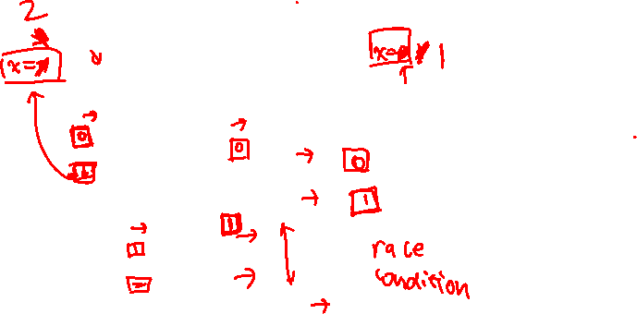







Question 1

Slide 19

Question 1
If two or more processes have their executions interleaved, it is very likely that one process will overwrite the value written by another process. In this case, it is impossible to have a deterministic value.
The reason why the number of increments and/or the number of processes must be large enough is to ensure that the processes do run at the same time in the system.
Note that it takes some time to setup the recently created process, and if this time exceeds the time required for the increment, then the processes won’t try to simultaneously read and write at the shared memory.

Slide 20

Question 2
Master Process:
workerPid[] = PID array for 1..N worker processes
N = number of inputs
inputs[] = N user inputs
// Give user input to the corresponding worker to work on
// Wait for each worker to finish and get back the result
Worker Process:
// get the user input to work from master
result = PrimeFactorization(input);
// send back the result to master

Slide 21

Question 2
Master Process:
workerPid[] = PID array for 1..N worker processes
N = number of inputs
inputs[] = N user inputs
// Give user input to the corresponding worker to work on
for i = 0 to N
send( workerPid[i], inputs[i] ); // non-blocking
// Wait for each worker to finish and get back the result
for i = 0 to N
receive( workerPid[i], result); // blocking
print result

Slide 22
Question 2
Worker Process:
// get the user input to work from master
receive(masterPid, input); // blocking
result = PrimeFactorization(input);
// send back the result to master
send(masterPid, result); // non blocking

Slide 23
Question 3a
a) For each of the following scenarios, discuss whether multithreading or multiprocessing is the best implementation model. If you think that both models have merits for a particular scenario, briefly describe additional criteria you would use to choose between the models.
i) Implementing a command line shell.

Slide 24
Question 3a
a) For each of the following scenarios, discuss whether multithreading or multiprocessing is the best implementation model. If you think that both models have merits for a particular scenario, briefly describe additional criteria you would use to choose between the models.
i) Implementing a command line shell.
Process model. Key points: Executing another program in the newly created process + Memory + Protection.

Slide 25
Question 3a
a) For each of the following scenarios, discuss whether multithreading or multiprocessing is the best implementation model. If you think that both models have merits for a particular scenario, briefly describe additional criteria you would use to choose between the models.
ii) Implementing the “tabbed browsing” in a web browser, i.e., each tab visits an independent webpage.

Slide 26
Question 3a
a) For each of the following scenarios, discuss whether multithreading or multiprocessing is the best implementation model. If you think that both models have merits for a particular scenario, briefly describe additional criteria you would use to choose between the models.
ii) Implementing the “tabbed browsing” in a web browser, i.e., each tab visits an independent webpage.
Arguable. Thread model (used by older Firefox) has lower overhead and suitable for less memory intensive webpages. Process model (used by most browsers nowadays) provides protection and can support multiple resource heavy webpages. In process model, if one tab becomes unresponsive while rendering, it will not affect other tabs because each tab’s rendering is handled by a process (isolation).

Slide 27
Question 3a
a) For each of the following scenarios, discuss whether multithreading or multiprocessing is the best implementation model. If you think that both models have merits for a particular scenario, briefly describe additional criteria you would use to choose between the models.
iii) Implementing a complex multi-player game with dynamic environments and sophisticated.

Slide 28
Question 3a
a) For each of the following scenarios, discuss whether multithreading or multiprocessing is the best implementation model. If you think that both models have merits for a particular scenario, briefly describe additional criteria you would use to choose between the models.
iii) Implementing a complex multi-player game with dynamic environments and sophisticated.
Thread model. Games can be time sensitive and the process model requires overheads that are not necessary in this context.

Slide 29
Question 3b
b) Suppose task A is CPU-intensive and task B is I/O intensive (reading from a file), which of the following statement(s) is/are TRUE if the two implementations are executed on a single CPU (single core)?
i) If the threads are implemented as user threads, then multithreaded implementation will finish execution in shorter amount of time compared to the sequential implementation.

Slide 30
Question 3b
b) Suppose task A is CPU-intensive and task B is I/O intensive (reading from a file), which of the following statement(s) is/are TRUE if the two implementations are executed on a single CPU (single core)?
i) If the threads are implemented as user threads, then multithreaded implementation will finish execution in shorter amount of time compared to the sequential implementation.
False: When Task B blocks for I/O, Task A is also blocked as the OS scheduler is not aware of user threads presence. A greater overhead from user thread scheduling will increase execution time compared to sequential implementation.

Slide 31
Question 3b
b) Suppose task A is CPU-intensive and task B is I/O intensive (reading from a file), which of the following statement(s) is/are TRUE if the two implementations are executed on a single CPU (single core)?
ii) If the threads are implemented as kernel threads, then multithreaded implementation will finish execution in shorter amount of time compared to the sequential implementation.

Slide 32
Question 3b
b) Suppose task A is CPU-intensive and task B is I/O intensive (reading from a file), which of the following statement(s) is/are TRUE if the two implementations are executed on a single CPU (single core)?
ii) If the threads are implemented as kernel threads, then multithreaded implementation will finish execution in shorter amount of time compared to the sequential implementation.
True: Task B can block while Task A still runs on CPU. This is because the OS scheduler is aware of the kernel threads. Execution will be faster than sequential implementation where Task A will block when Task B requests I/O

Slide 33

Question 4a
Process ID | Number of User Threads | Number of Kernel Threads
P1 | U1 | K1
P2 | U2 | K2
P3 | U3 | K3
Suppose we have the following multi‐threaded processes on a hybrid thread model:
i) If all threads are CPU intensive and run forever, what is the approximate proportion of CPU time utilized by the process P3 after running for a long time? You can assume a pre-emptive and fair process scheduler is used by the OS.

Slide 34
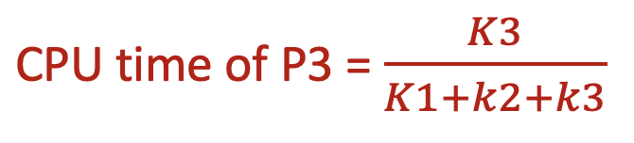
Question 4a
Process ID | Number of User Threads | Number of Kernel Threads
P1 | U1 | K1
P2 | U2 | K2
P3 | U3 | K3
Suppose we have the following multi‐threaded processes on a hybrid thread model:
i) If all threads are CPU intensive and run forever, what is the approximate proportion of CPU time utilized by the process P3 after running for a long time? You can assume a pre-emptive and fair process scheduler is used by the OS.

Slide 35
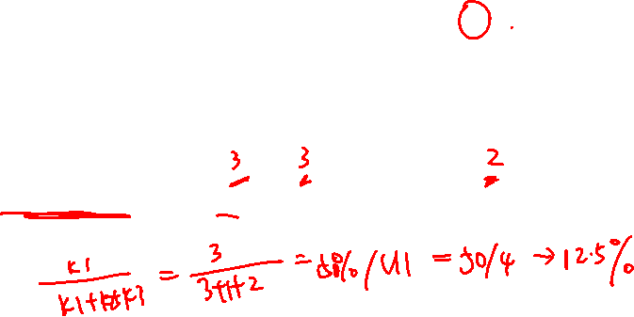
Question 4a
Process ID | Number of User Threads | Number of Kernel Threads
P1 | U1 | K1
P2 | U2 | K2
P3 | U3 | K3
Suppose we have the following multi‐threaded processes on a hybrid thread model:
ii) When [U1 = 4, K1 = 1] [U2 = 1, K2 = 1] [U3 = 5, K3 = 3] what is the CPU utilization by one user thread of process P1? Does the number of user threads of other process affect this value? State your assumptions.

Slide 36

Question 4a
Process ID | Number of User Threads | Number of Kernel Threads
P1 | U1 | K1
P2 | U2 | K2
P3 | U3 | K3
Suppose we have the following multi‐threaded processes on a hybrid thread model:
ii) When [U1 = 4, K1 = 3] [U2 = 3, K2 = 1] [U3 = 5, K3 = 2] what is the CPU utilization by one user thread of process P1? Does the number of user threads of other process affect this value? State your assumptions.
12.5%. 50% of CPU time is allocated to entire Process P1. If user thread library allocates resources equally between user threads, one thread receives 50% / 4 = 12.5% of CPU time
This question tests the distinction between user thread and kernel thread. Only the latter is visible to OS (i.e. schedulable). So, regardless of the binding between user and kernel thread, it is the number of kernel threads that determine the CPU received.

Slide 37
Question 4b
b) Evaluate each of the following statements regarding Thread and POSIX Thread (pthread) as True or False.
i) All pthreads must execute the same function when they start.

Slide 38

Question 4b
b) Evaluate each of the following statements regarding Thread and POSIX Thread (pthread) as True or False.
i) All pthreads must execute the same function when they start.
False: Pthread can start on any function as long as the function signature is void* f(void*)
(check the man page of pthread_create)

Slide 39
Question 4b
b) Evaluate each of the following statements regarding Thread and POSIX Thread (pthread) as True or False.
ii) Multi-threaded program using pure user threads can never exploit multi-core processors.

Slide 40
Question 4b
b) Evaluate each of the following statements regarding Thread and POSIX Thread (pthread) as True or False.
ii) Multi-threaded program using pure user threads can never exploit multi-core processors.
True: This is the main short coming of user thread as OS is not aware of the threads.

Slide 41
Question 4b
b) Evaluate each of the following statements regarding Thread and POSIX Thread (pthread) as True or False.
iii) If we use a 1-to-1 binding in a hybrid thread model, the end result is the same as pure-user thread model.

Slide 42

Question 4b
b) Evaluate each of the following statements regarding Thread and POSIX Thread (pthread) as True or False.
iii) If we use a 1-to-1 binding in a hybrid thread model, the end result is the same as pure-user thread model.
False: The result is a pure kernel-thread model as each user thread is bounded to a kernel thread that can be scheduled.

Slide 43
Question 4b
b) Evaluate each of the following statements regarding Thread and POSIX Thread (pthread) as True or False.
iv) On a single-core processor that supports simultaneous multithreading, we can execute more than one thread at the same time.

Slide 44
Question 4b
b) Evaluate each of the following statements regarding Thread and POSIX Thread (pthread) as True or False.
iv) On a single-core processor that supports simultaneous multithreading, we can execute more than one thread at the same time.
True: Hardware support on modern processors supports simultanious multi-threading that allow threads to run natively and in parallel on the same core (e.g. hyperthreading on Intel processor)

Slide 45

Optional
we would like to modify the code in shm.c such that the output is deterministic regardless of how large n and nChild are. More precisely, we want the processes to take turns when modifying the result value that resides in the shared memory. To this end, we will add another field in the shared memory, called the order value, that specifies which process’ turn it is to increment the shared result. Each process has an associated pOrder and checks whether the value order is equal to its pOrder; if it is, then it proceeds to increment the shared result. Otherwise, it waits until the order value is equal to its pOrder.
Your task is to modify the code in shm_protected.c to achieve the desired result. You will have to:
a) Create a shared memory region with two locations, one for the shared result, and the other one for the order value;
b) Write the logic that allows a process to modify the shared result only if the order value is equal to its pOrder (the skeleton already takes care of assigning the right pOrder to each process);
c) Print the result value and cleanup the shared memory.
Why is shm faster than shm_protected? Why is running shm_protected with large values for nChild particularly slow?

Slide 46
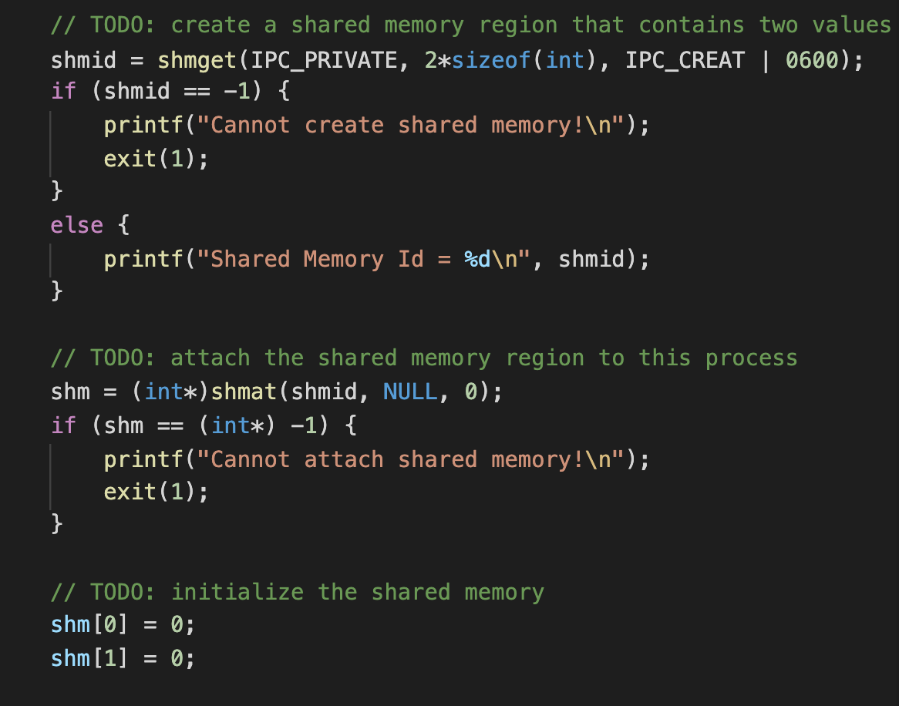

Optional

Slide 47
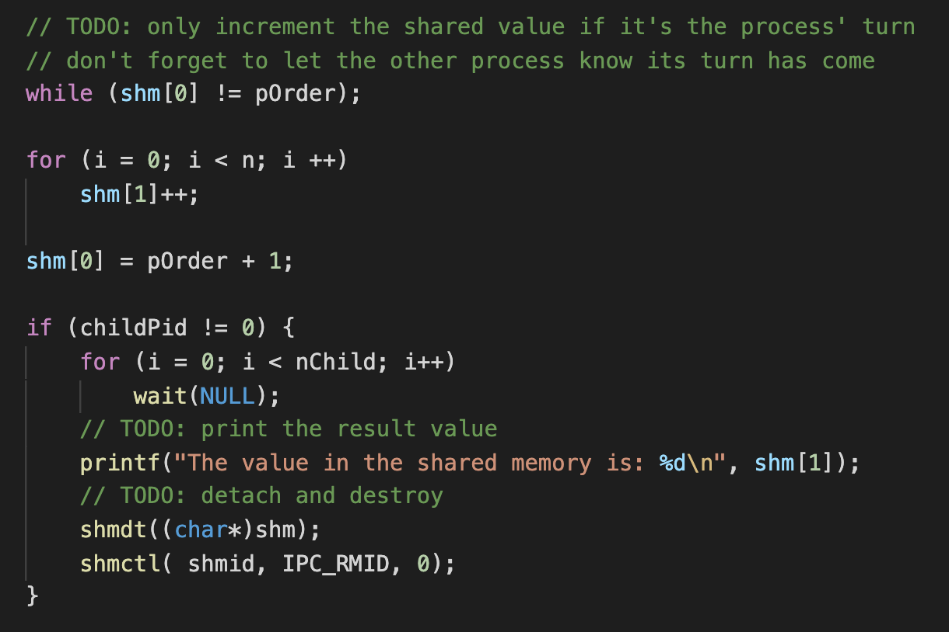
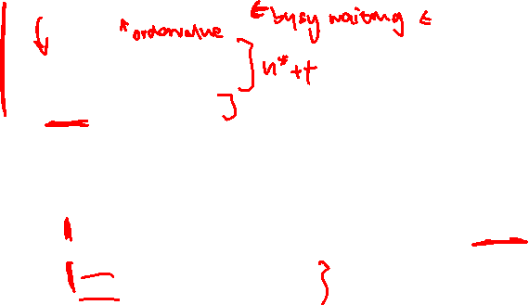
Optional

Slide 48
Optional
Why is shm faster than shm_protected? Why is running shm_protected with large values for nChild particularly slow?
Answer:
To guarantee that two processes won’t try to modify the shared memory location at the same time, we must serialize the access to it, i.e., make it impossible for two processes to have access to it at the same time. Serializing the code will, of course, make the execution time longer.
The technique we use to prevent simultaneous access is called busy waiting. Each process is continuously checking whether its time to modify the variable has come. This requires the process to run on the CPU and consume CPU cycles (thus the name). Note that at the moment when it’s Child X’s time to increment the value, there are nChild – X processes doing busy waiting – each of these processes will get scheduled to run on the CPU but the execution of the program will not make any progress. Because of this, your program will take a long time to complete for large values of nChild.

Slide 49
Consultation
Will be sending link to book consultation slots via email

Slide 50
Thank you!
All the best for your midterm preparation & lab 2

